Slide 1
The Last Week
Of Jesus’ Life
The Resurrection (continued)
1 Corinthians 15:1-19
December 14, 2022

Slide 2
Jesus’ First Appearance
Mary Magdalene. Mark 16:9-11; John 20:11-18
It was upon the first day of the week. Matthew 28:1, “Now late on the sabbath day, as it began to dawn toward the first (day) of the week, came Mary Magdalene and the other Mary to see the sepulchre.”
John 20:14, “When she had thus said, she turned herself back, and beholdeth Jesus standing, and knew not that it was Jesus.”
Apparently He was “manifested in another form” when He showed Himself to the disciples (see Mark 16:12; and compare Matthew 28:17; Luke 24:15-16, 36-37; and John 21:4).
Note: The disciples did not believe her. Mark 16:10-11

Slide 3
Jesus’ Second Appearance
Mary Magdalene and the women: Go tell the brethren to go to Galilee. Matthew 28:8-10;
Luke 24:9-11
“Worshiped him”.
  She obeyed the Lord’s instruction to go and report her experience (Mark 16:10; cf. Matthew 28:10 and
  Luke 24:10).
NOTE: The eleven and others did not believe them. Luke 24:9-11

Slide 4
The Report Of The Guard
Matthew 28:11-15
“Now while they were going, behold, some of the guard came into the city, and told unto the chief priests all the things that were come to pass. And when they were assembled with the elders, and had taken counsel, they gave much money unto the soldiers, saying, Say ye, His disciples came by night, and stole him away while we slept. And if this come to the governor’s ears, we will persuade him, and rid you of care. So they took the money, and did as they were taught: and this saying was spread abroad among the Jews, (and continueth) until this day.”

Slide 5
The Report Of The Guard
Matthew 28:11-15
Instructed the “watchers” to lie.
Matthew 28:15, “So they took the money, and did as they were taught: and this saying was spread abroad among the Jews, (and continueth) until this day.”
Note: Concern of the soldiers.
“And if this come to the governor’s ears, we will persuade him, and rid you of care.”

Slide 6
Jesus’ Third Appearance
Luke 24:34; 1 Corinthians 15:5
Peter.
“Simon.” This appearance to Peter came some time after Peter’s and John’s visit to the tomb.

Slide 7
Jesus’ Fourth Appearance
Mark 16:12-13; Luke 24:13-35
The two disciples on their way to Emmaus.
Luke 24:25, “And he said unto them, O foolish men, and slow of heart to believe in all that the prophets have spoken!”
(see for example Psalms 2, 16, 110; Isaiah 53).
Hastened to return and report to the eleven.

Slide 8
Jesus’ Fifth Appearance
Mark 16:14; Luke 24:36-43; John 20:19-25
The eleven (minus one). Thomas was absent. John 20:24-26; 1 Corinthians 15:5

Slide 9
Jesus’ Sixth Appearance
John 20:26-28
To the disciples, including Thomas. (“after 8 days”)
John 20:27-28, “Then saith he to Thomas, Reach hither thy finger, and see my hands; and reach (hither) thy hand, and put it into my side: and be not faithless, but believing. Thomas answered and said unto him, My Lord and my God.”
cf. John 20:30-31; 1 John 1:1, 3

Slide 10
The Galilean Appearances
Jesus had told the disciples before His death that after the resurrection He would go into Galilee. Matthew 26:32;
Mark 14:28
The angels at the empty tomb told the women to tell the disciples that Jesus would go to Galilee. Matthew 28:7;
Mark 16:7
Jesus told the women to tell the disciples to go to Galilee and He would see them there. Matthew 28:10
Therefore, sometime after the appearance with the disciples including Thomas, the disciples returned to Galilee.

Slide 11
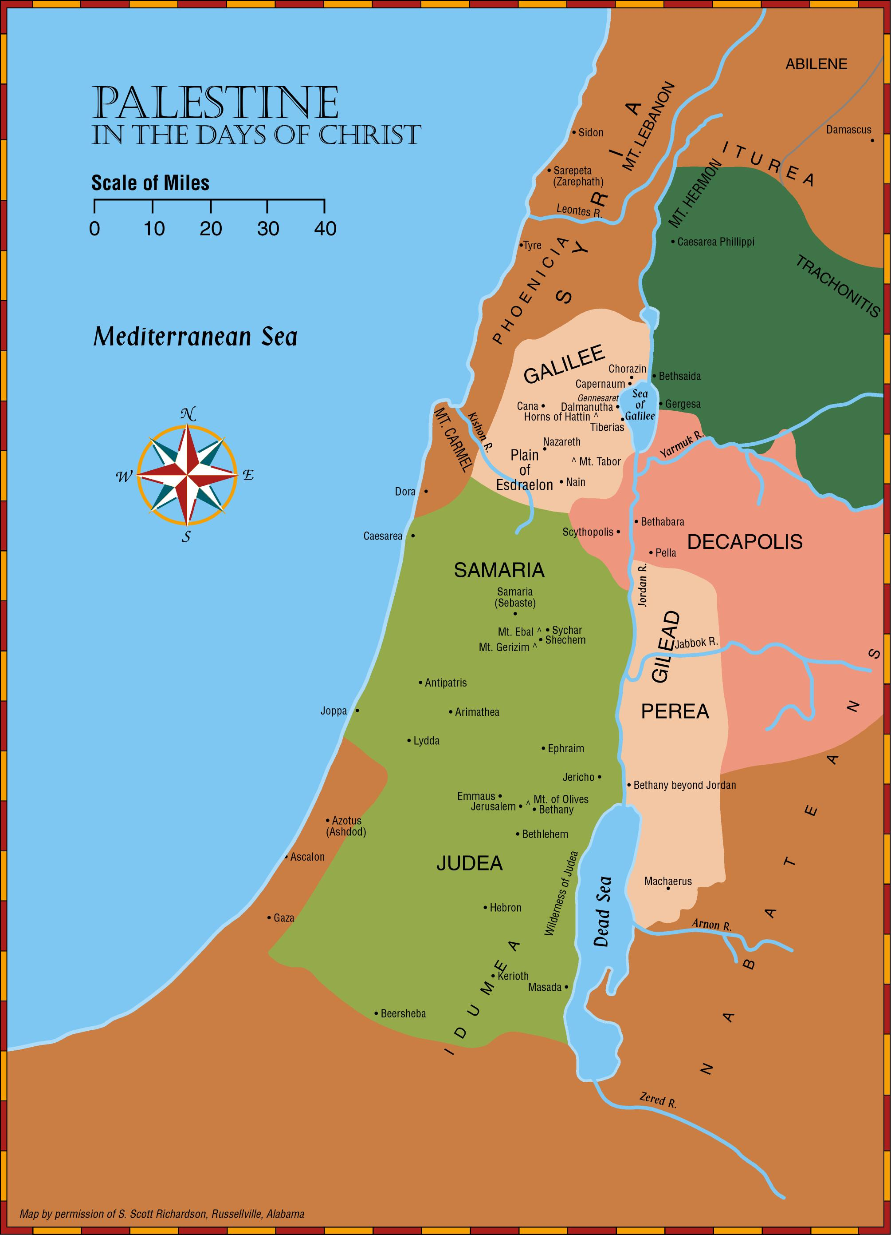
About 80 miles

Slide 12
Jesus’ Seventh Appearance
John 21:1-14
The seven disciples at the Sea of Galilee.
(This was the third appearance to the disciples.)
Simon Peter, Thomas called Didymus, Nathanael of Cana in Galilee, Sons of Zebedee (James and John), and two others.
Great catch of fish.
  It was not “luck” that produced the drought of fishes either here or in Luke 5:1-11, but the Lord’s miraculous power.

Slide 13
Jesus’ Appearances After The Resurrection
Many more appearances over 40 days.
Acts 1:1-3; 1 Corinthians 15:3-8

Slide 14
The Last Week
Of Jesus’ Life
The Resurrection (The Ascension)
1 Corinthians 15:1-19
December 14, 2022

Slide 15
The Resurrection,
This was the fundamental message preached to the world. Acts 2, 3, 4, 5; 10:40-41; 13:30-31; 17:3, 30-31; cf. 1 Corinthians 15:1-4, 12-20
Romans 1:1-4, “Paul, a servant of Jesus Christ, called (to be) an apostle, separated unto the gospel of God, which he promised afore through his prophets in the holy scriptures, concerning his Son, who was born of the seed of David according to the flesh, who was declared (to be) the Son of God with power, according to the spirit of holiness, by the resurrection from the dead; (even) Jesus Christ our Lord”

Slide 16
Evidence – Appearances
The tomb was found empty. Luke 24:1-8 “Why seek ye the living among the dead? He is not here, but is risen.”
Mary Magdalene. Mark 16:9-11; John 20:11-18
The women. Matthew 28:9-10; Luke 24:9-11
Peter. Luke 24:34
The two disciples on their way to Emmaus.
Luke 24:13-15
The eleven (minus one). Luke 24:36-43
To the disciples, including Thomas.
John 20:24-28
The seven disciples at the Sea of Galilee.
John 21:1-14

Slide 17
Jesus’ Eighth Appearance
Matthew 28:16-20; Mark 16:15-16; Luke 24:46-47
The eleven disciples on a mountain in Galilee.
They worshipped Him.
He gave them the “great commission.”
“Then” … Over 500 at once. (1 Corinthians 15:6)
  If the appearance recorded in Matthew 28:7, 10, 16-20 is not the one to which Paul was referring, this resurrection appearance is not mentioned elsewhere in the New Testament.

